Slide 1
Cultural & Linguistic Diversity
As Seen by Angielena Williams

Slide 2
My Definition
My definition of a strength-based approach/perspective with regard to culturally and linguistically diverse populations in early childhood settings is multi-faceted. “For young children to develop and learn optimally, the early childhood professional must be prepared to meet their diverse developmental, cultural, linguistic, and educational needs” (NAEYC, 1995). Identifying, learning about and collaborating with the families of the children enrolled in the program is key to finding out more about current skills as they relate to the home and English language, socialization and overall development. Building on those findings, can establish meaningful communicative relationships, respect for each others culture, and a determination to create a continuum of individualized care and support.

Slide 3
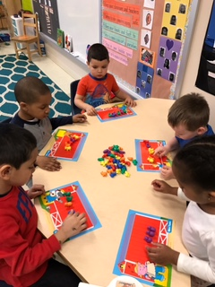
Factors as strengths #1
“Acknowledge that children can demonstrate their knowledge and capabilities in many ways” (NAEYC, 1995). The picture that I have chosen for this strength is of one of my small groups in which I have two of my ELL students with my EL students, problem solving together during a math activity in which they had to identify the number in their home language or English, then count out that many farm animals.

Slide 4
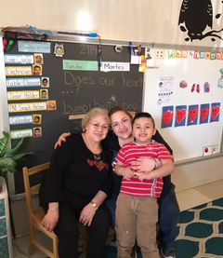
Factors as strengths #2
“Every child, regardless of his or her personal and family situation, has strengths that are unique to the individual” (Rudolph, S. M., & Epstein, M. H. 2000). This family has four generations of family living under one roof and they all support one another in every aspect of life, to include early childhood education. I have had this student for two years now and this year, a cousin. This family is always involved in what we do.

Slide 5
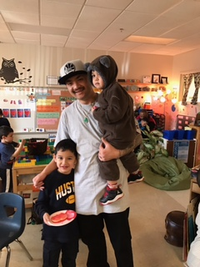
Factors as strengths #3
“Children are influenced and motivated by the way significant people in their lives respond to them” (NAEYC, 1995). In this particular family (Vietnamese) the father is the main figure head when it comes to emails, conferences, and discussions about how to better influence more interaction and language learning with their son. Mom is sweet and very involved, but quiet when dad is present. Totally cultural and respected.

Slide 6
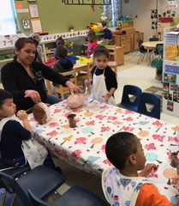
Factors as strengths #4
“Understand that without comprehensible input, second language learning can be difficult” (NAEYC, 1995). There are times that I strategically place my IA (Spanish native language) in a group with ELL students when more explanation is needed to complete a project, like our dinosaur eggs. My Spanish is very limited, conversational at best. Karina is a very valuable resource in allowing the students to not only hear, but comprehend the expectation, fostering a sense of accomplishment.

Slide 7
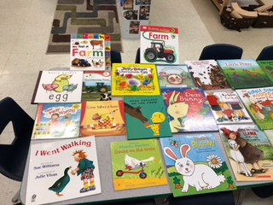
Factors as strengths #5
“Encourage and assist all parents in becoming knowledgeable about the cognitive value for children knowing more than one language, and provide them with strategies to support, maintain, and preserve home-language learning” (NAEYC, 1995). I have a selection of reading materials that I send home with all parents in their home language, when possible. I also have a Take Home Friend that we send home with English-Spanish translations, and a few in Vietnamese.

Slide 8
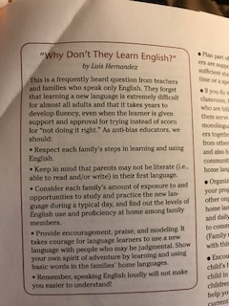
Factors as strengths #6
In the text, Anti-Bias Education for Ourselves and Young Children and Ourselves (Derman-Sparks & Edwards, 2010), they discuss an article entitled, ‘Why Don’t They Learn English?” (Luis Hernandez) and provide insights to how to reflect and be considerate of the time and concentration that it takes for any one person to learn a language, let alone more than one. Embrace it!

Slide 9
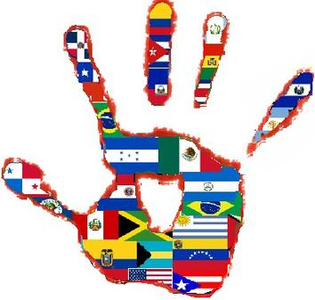
Factors as strengths #7
Include the cultures that you have in your classroom and turn them into learning opportunities for not only you, but for the other students in your classroom. At the beginning of the school year, send home a family survey and ask the parent about their families celebrations, holidays, foods, and beliefs. Invite them to come in and share about their culture and customs.

Slide 10
references
Derman-Sparks, L. & Edwards, J.O. (2010). Anti-Bias Education for Young Children and Ourselves, NAEYC; Washington, DC
National Association for the Education of Young Children. (1995). Responding to linguistic and cultural diversity: Recommendations for effective early childhood education. Retrieved from http://www.naeyc.org/files/naeyc/file/positions/PSDIV98.PDF
Rudolph, S. M., & Epstein, M. H. (2000). Empowering children and families through strength-based assessment. Reclaiming Children and Youth, 8(4), 207-209. Retrieved fromhttp://search.proquest.com/openview/5b46dc4a5906615b92a2f8fa7714c460/1?pq-origsite=gscholar

