Slide 1

Wake Up ECE…and be inspired!
“A Day in the Life” Personal ECE Journey-by Angielena Williams

Slide 2
“Tell me, what is it you plan to do with your one wild and precious life?” - Mary Oliver

Slide 3




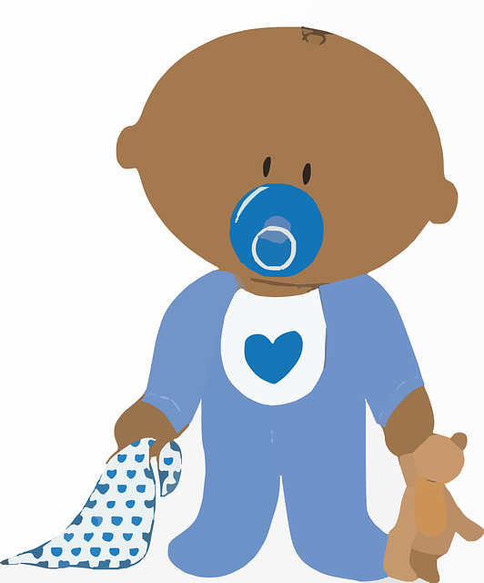

My ECE journey began when…
This Photo by Unknown Author is licensed under CC BY
This Photo by Unknown Author is licensed under CC BY-NC

Slide 4
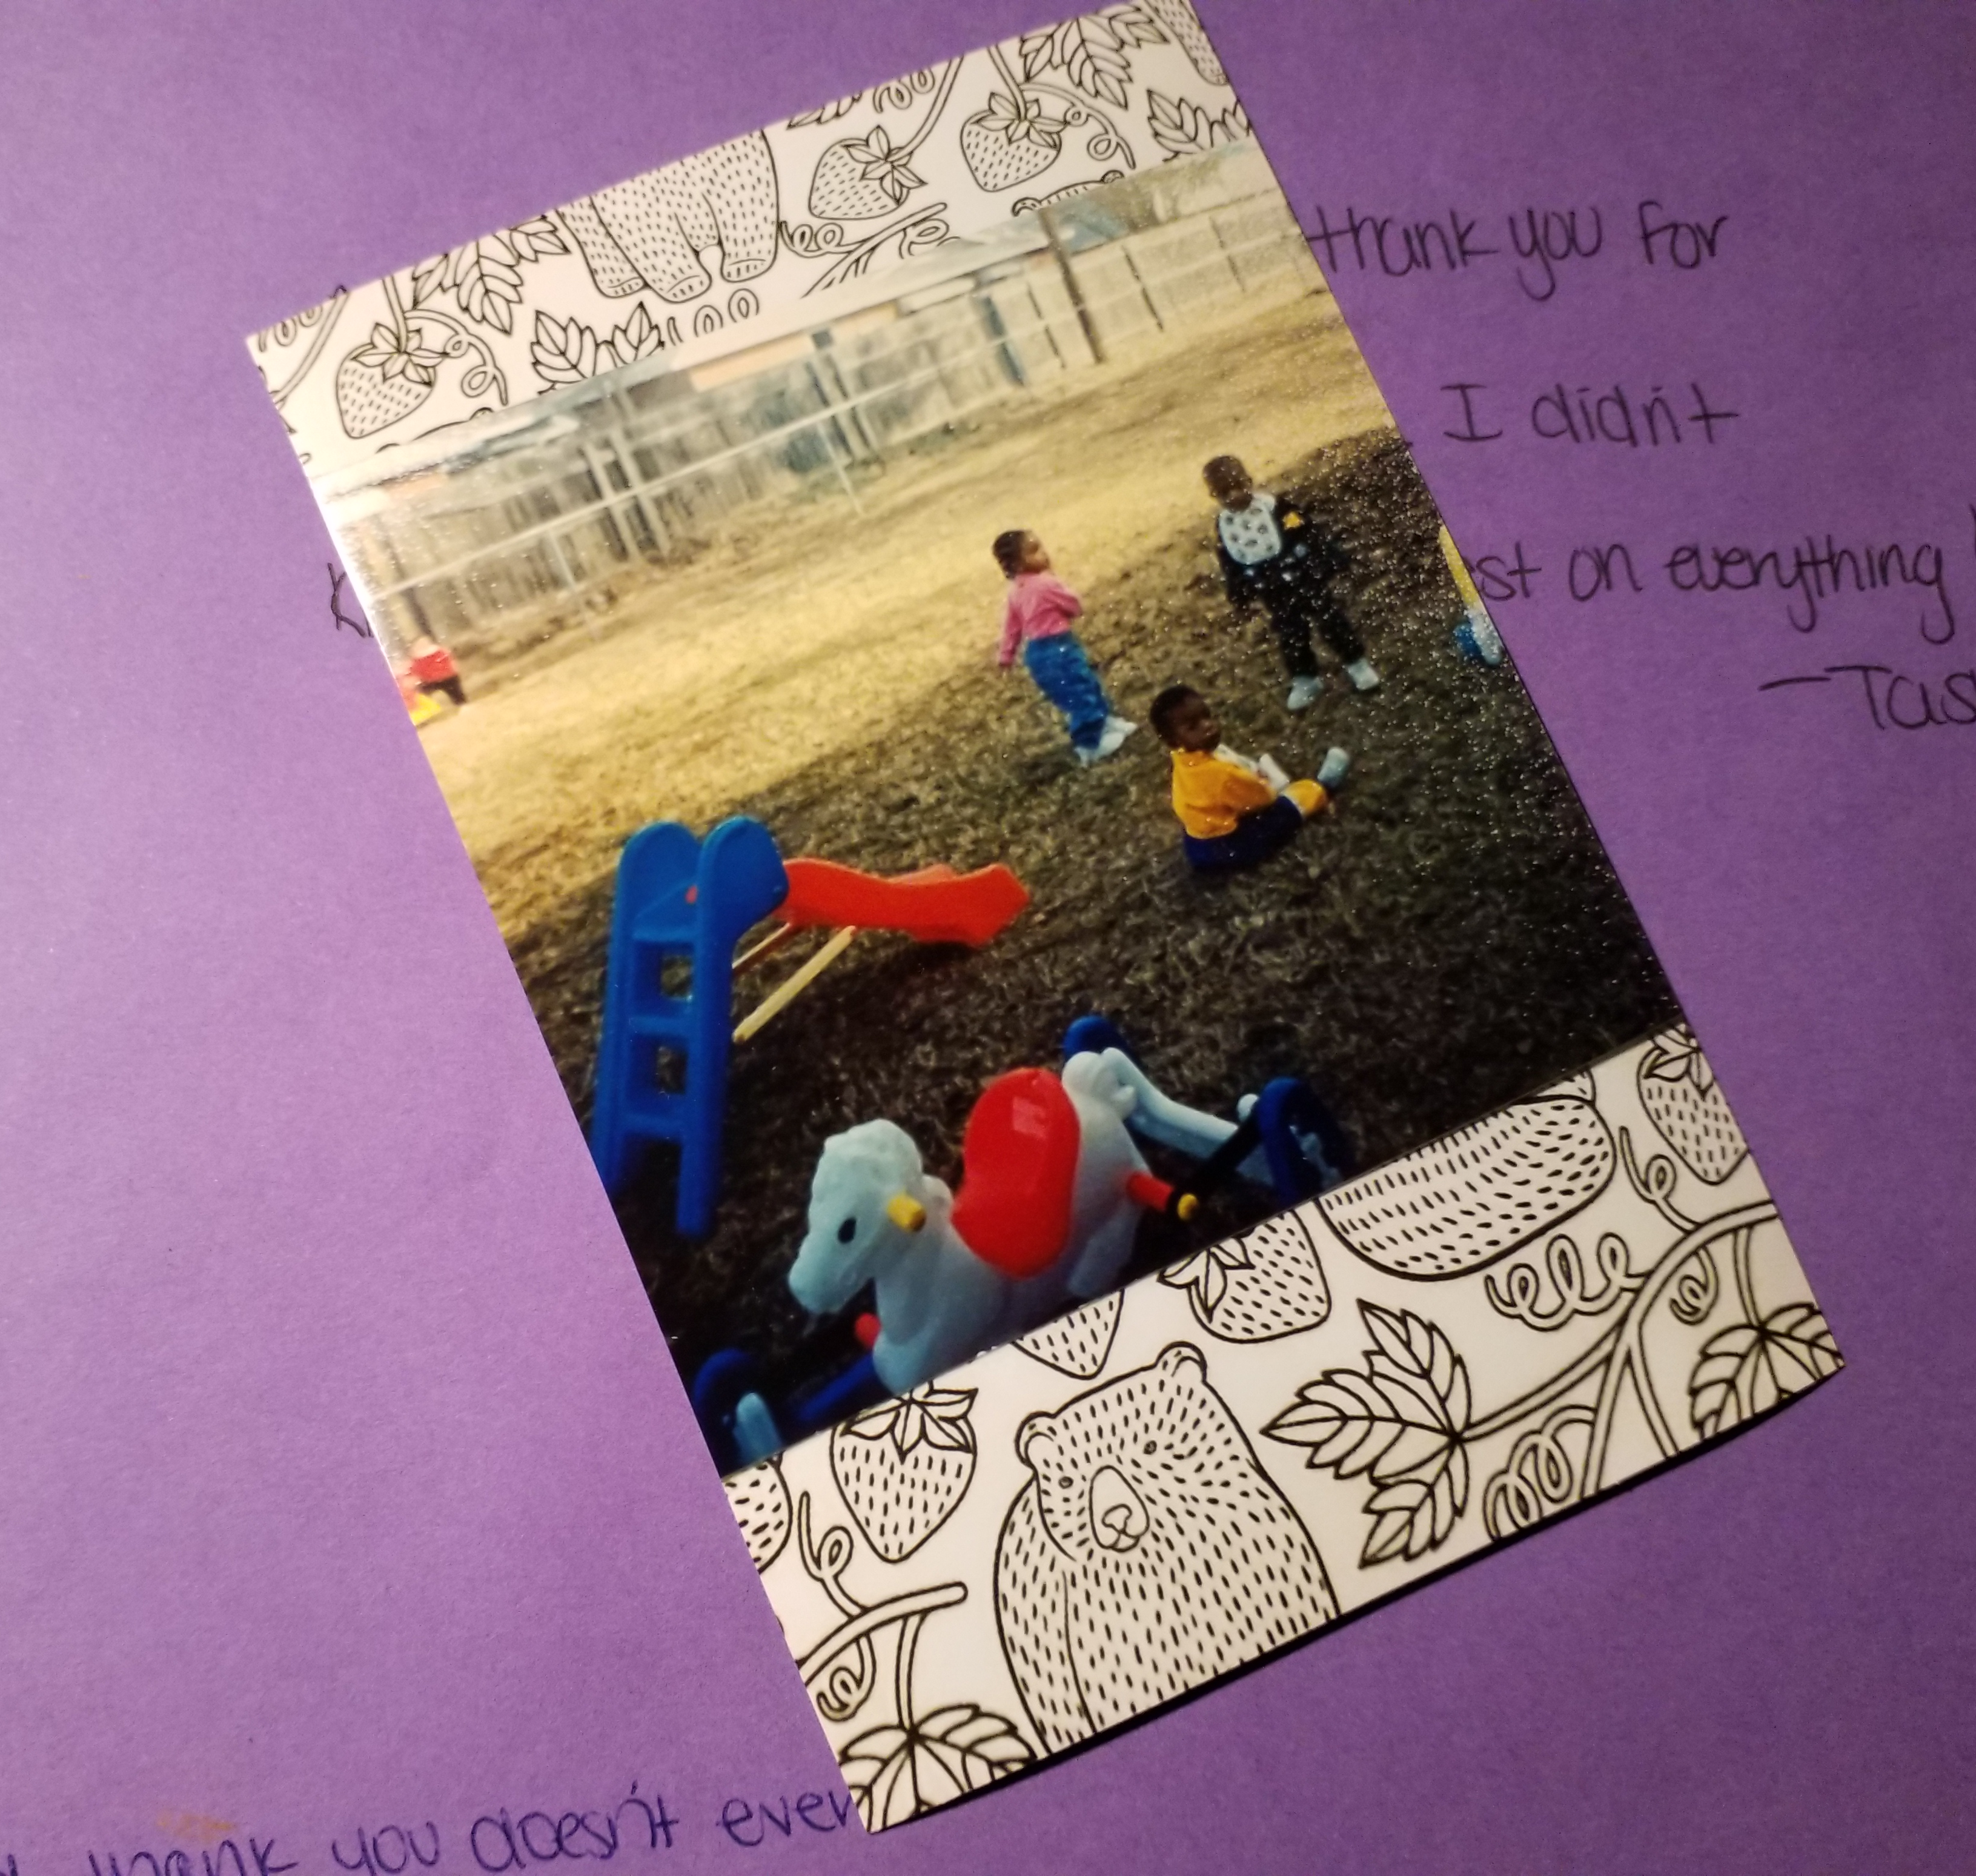
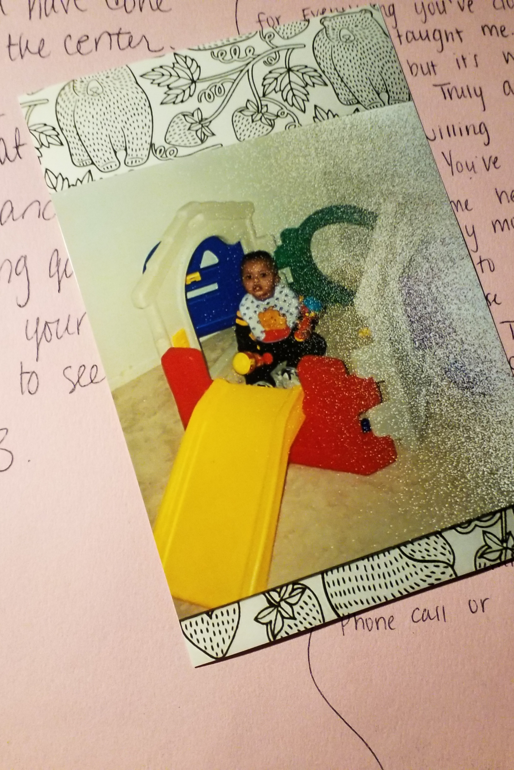
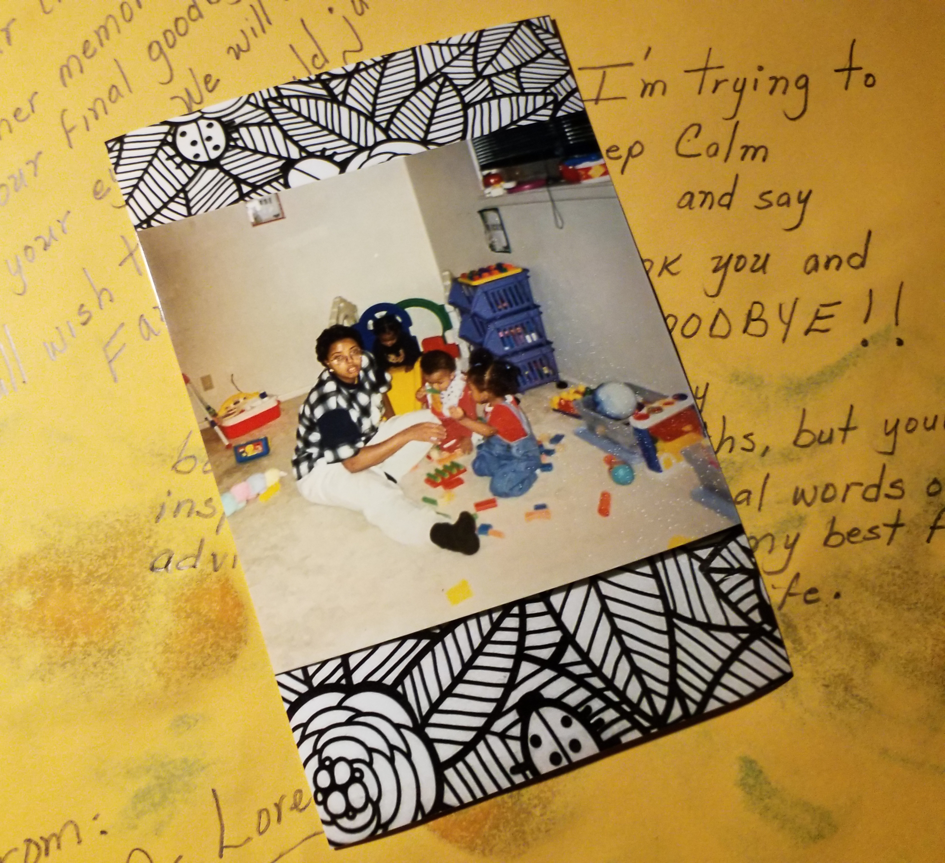
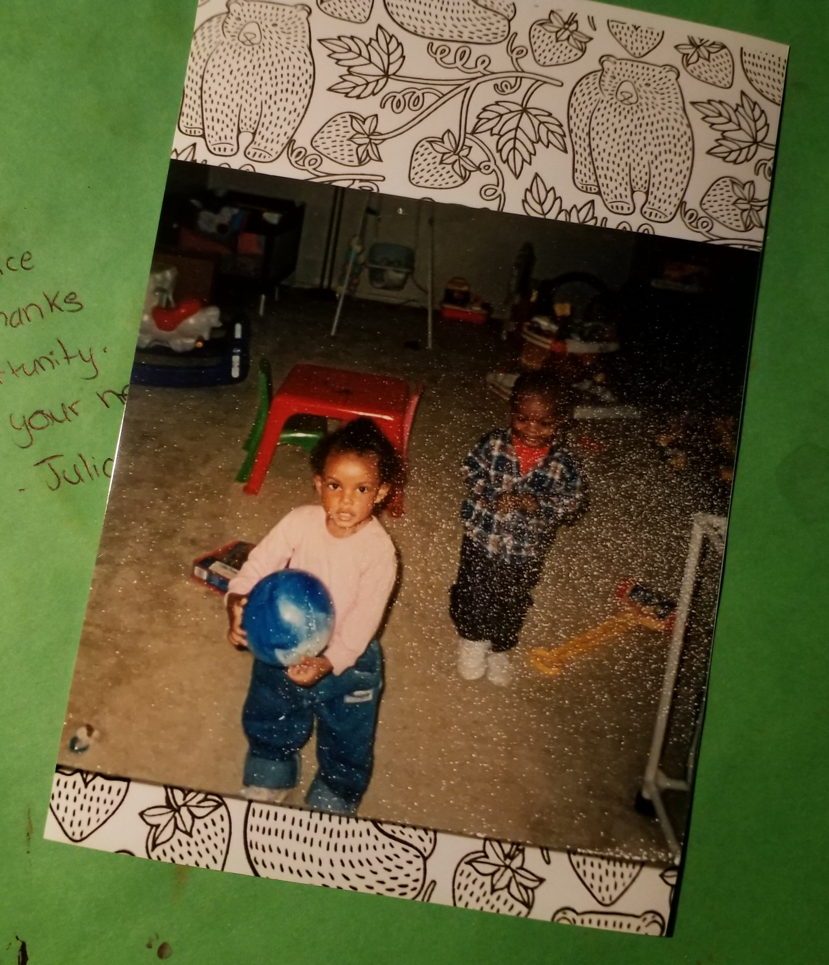
I made the call…
Contacted the State’s Office of Family and Social Services
Registered the name of my new family child care home
Attended the required state trainings
Put together an inexpensive marketing plan
Began word-of-mouth advertising with military associates
Received my very first family October 1998

Slide 5
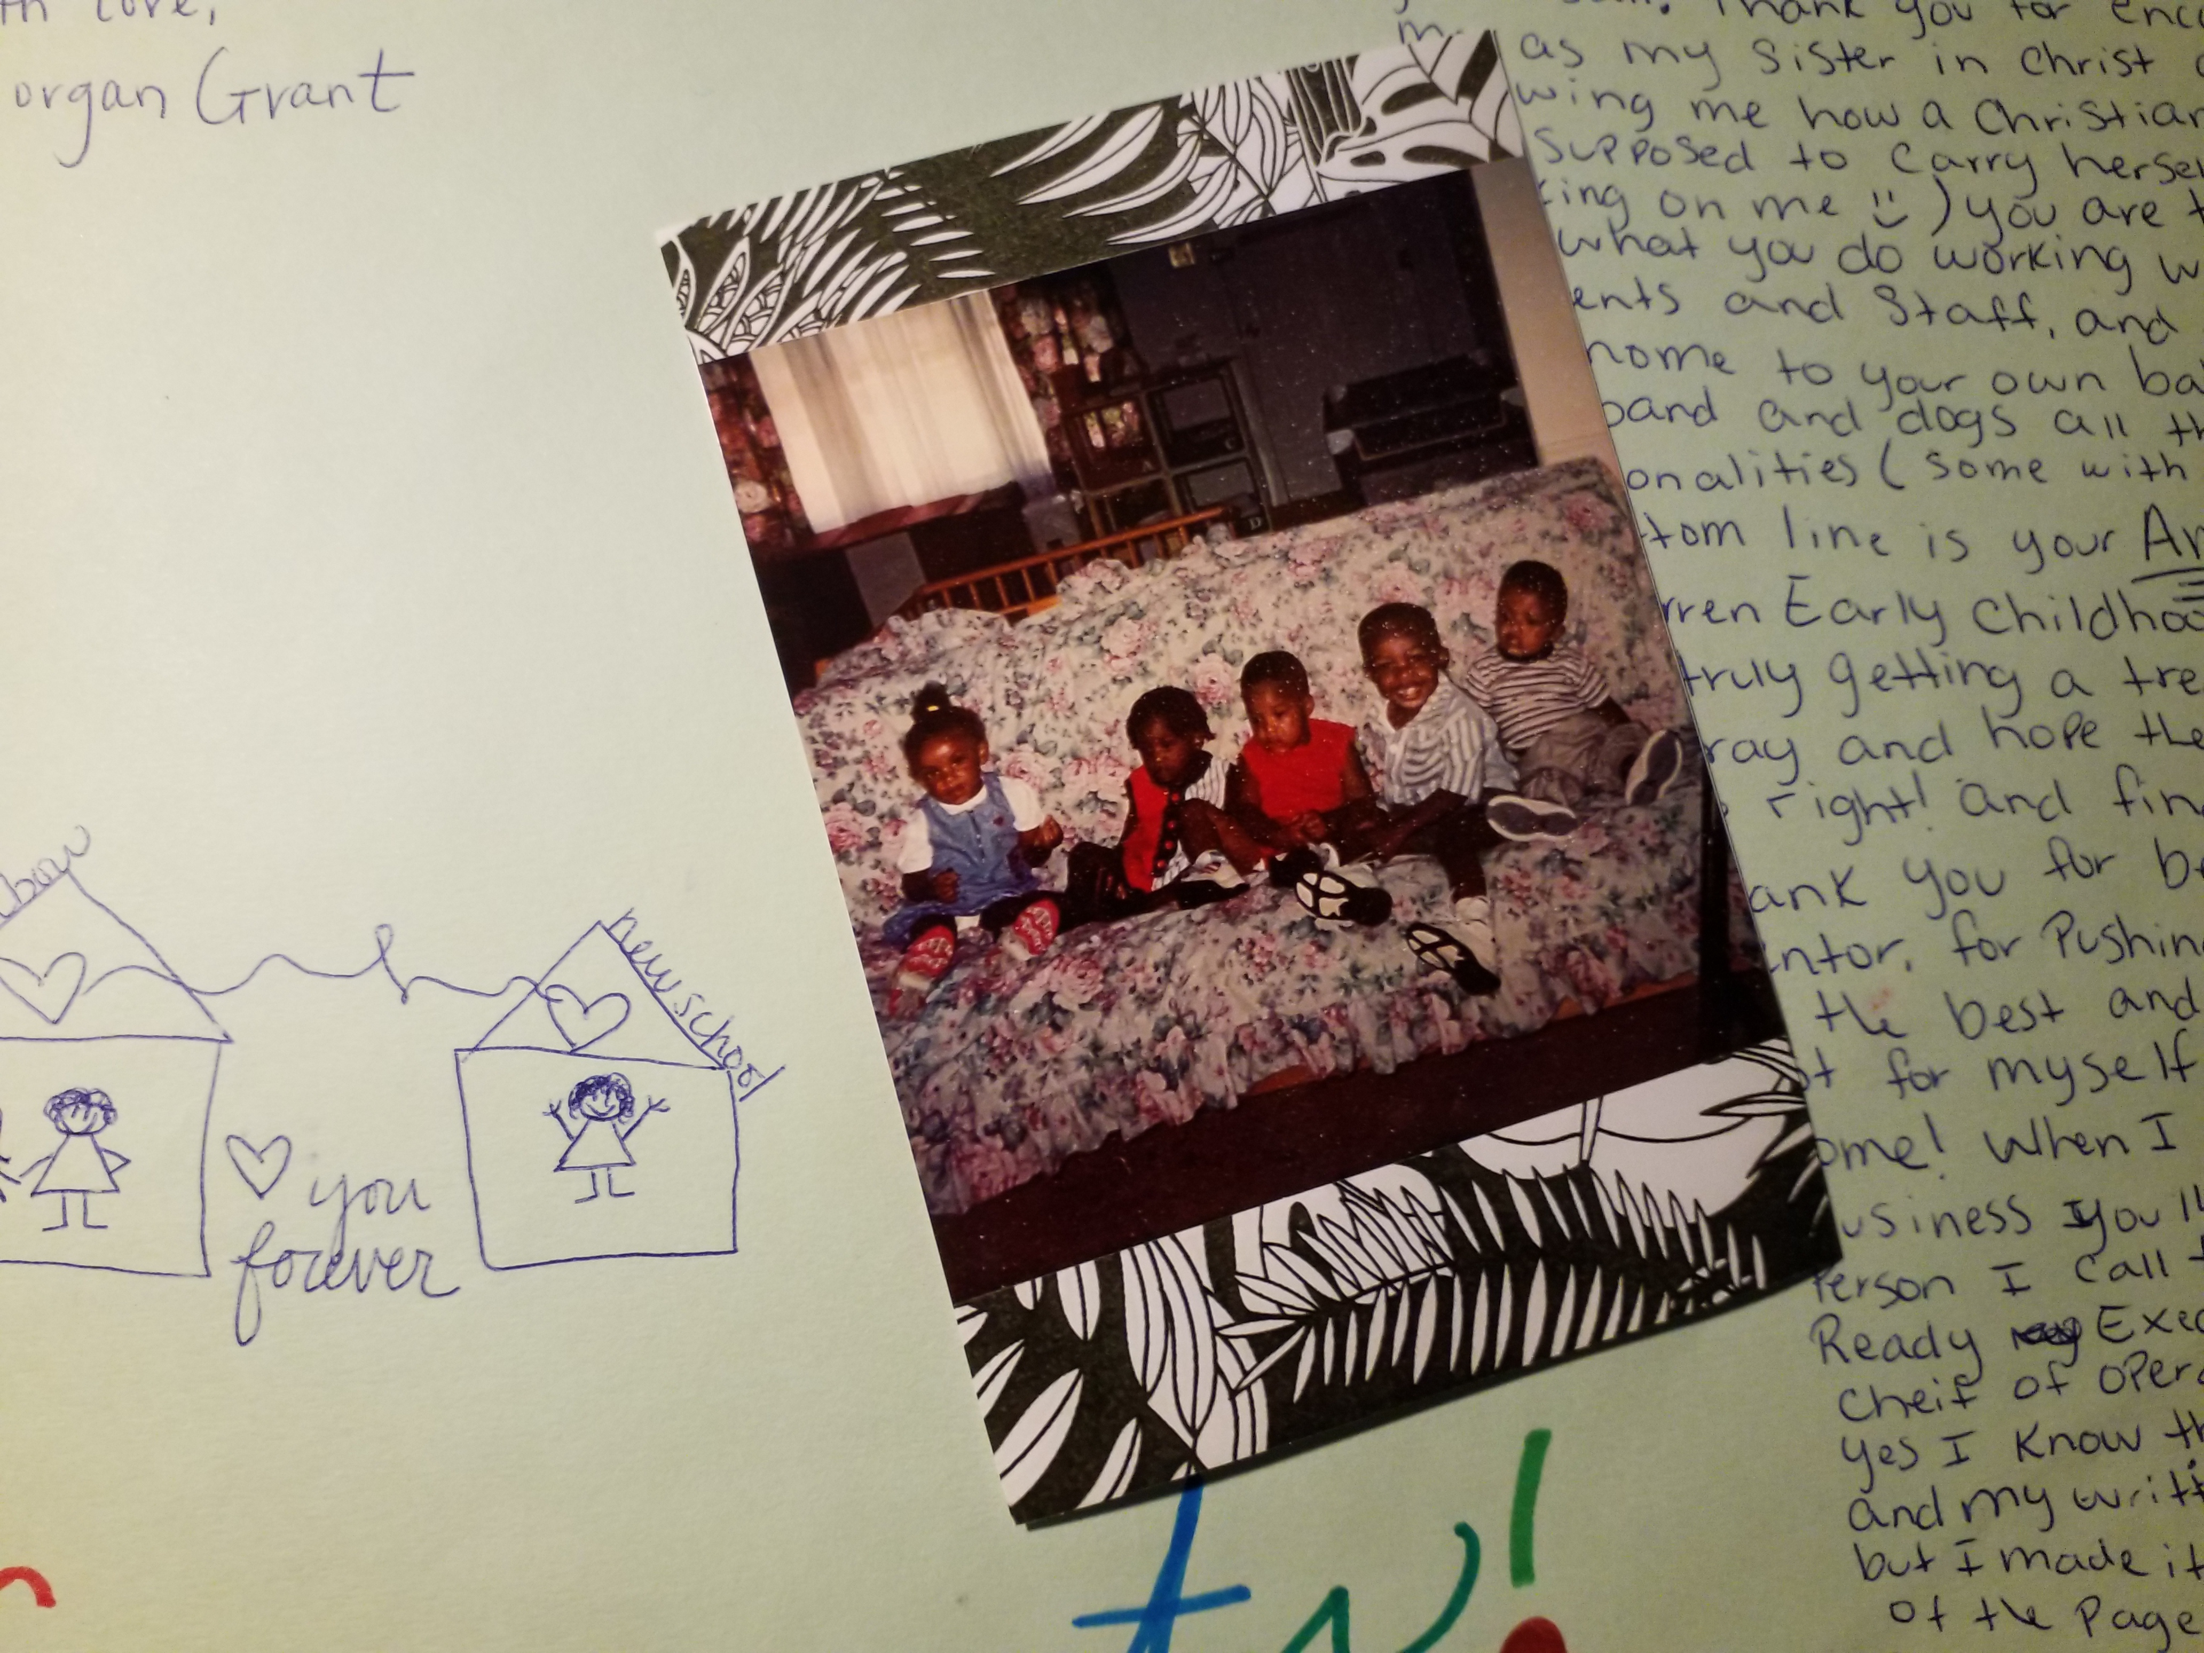
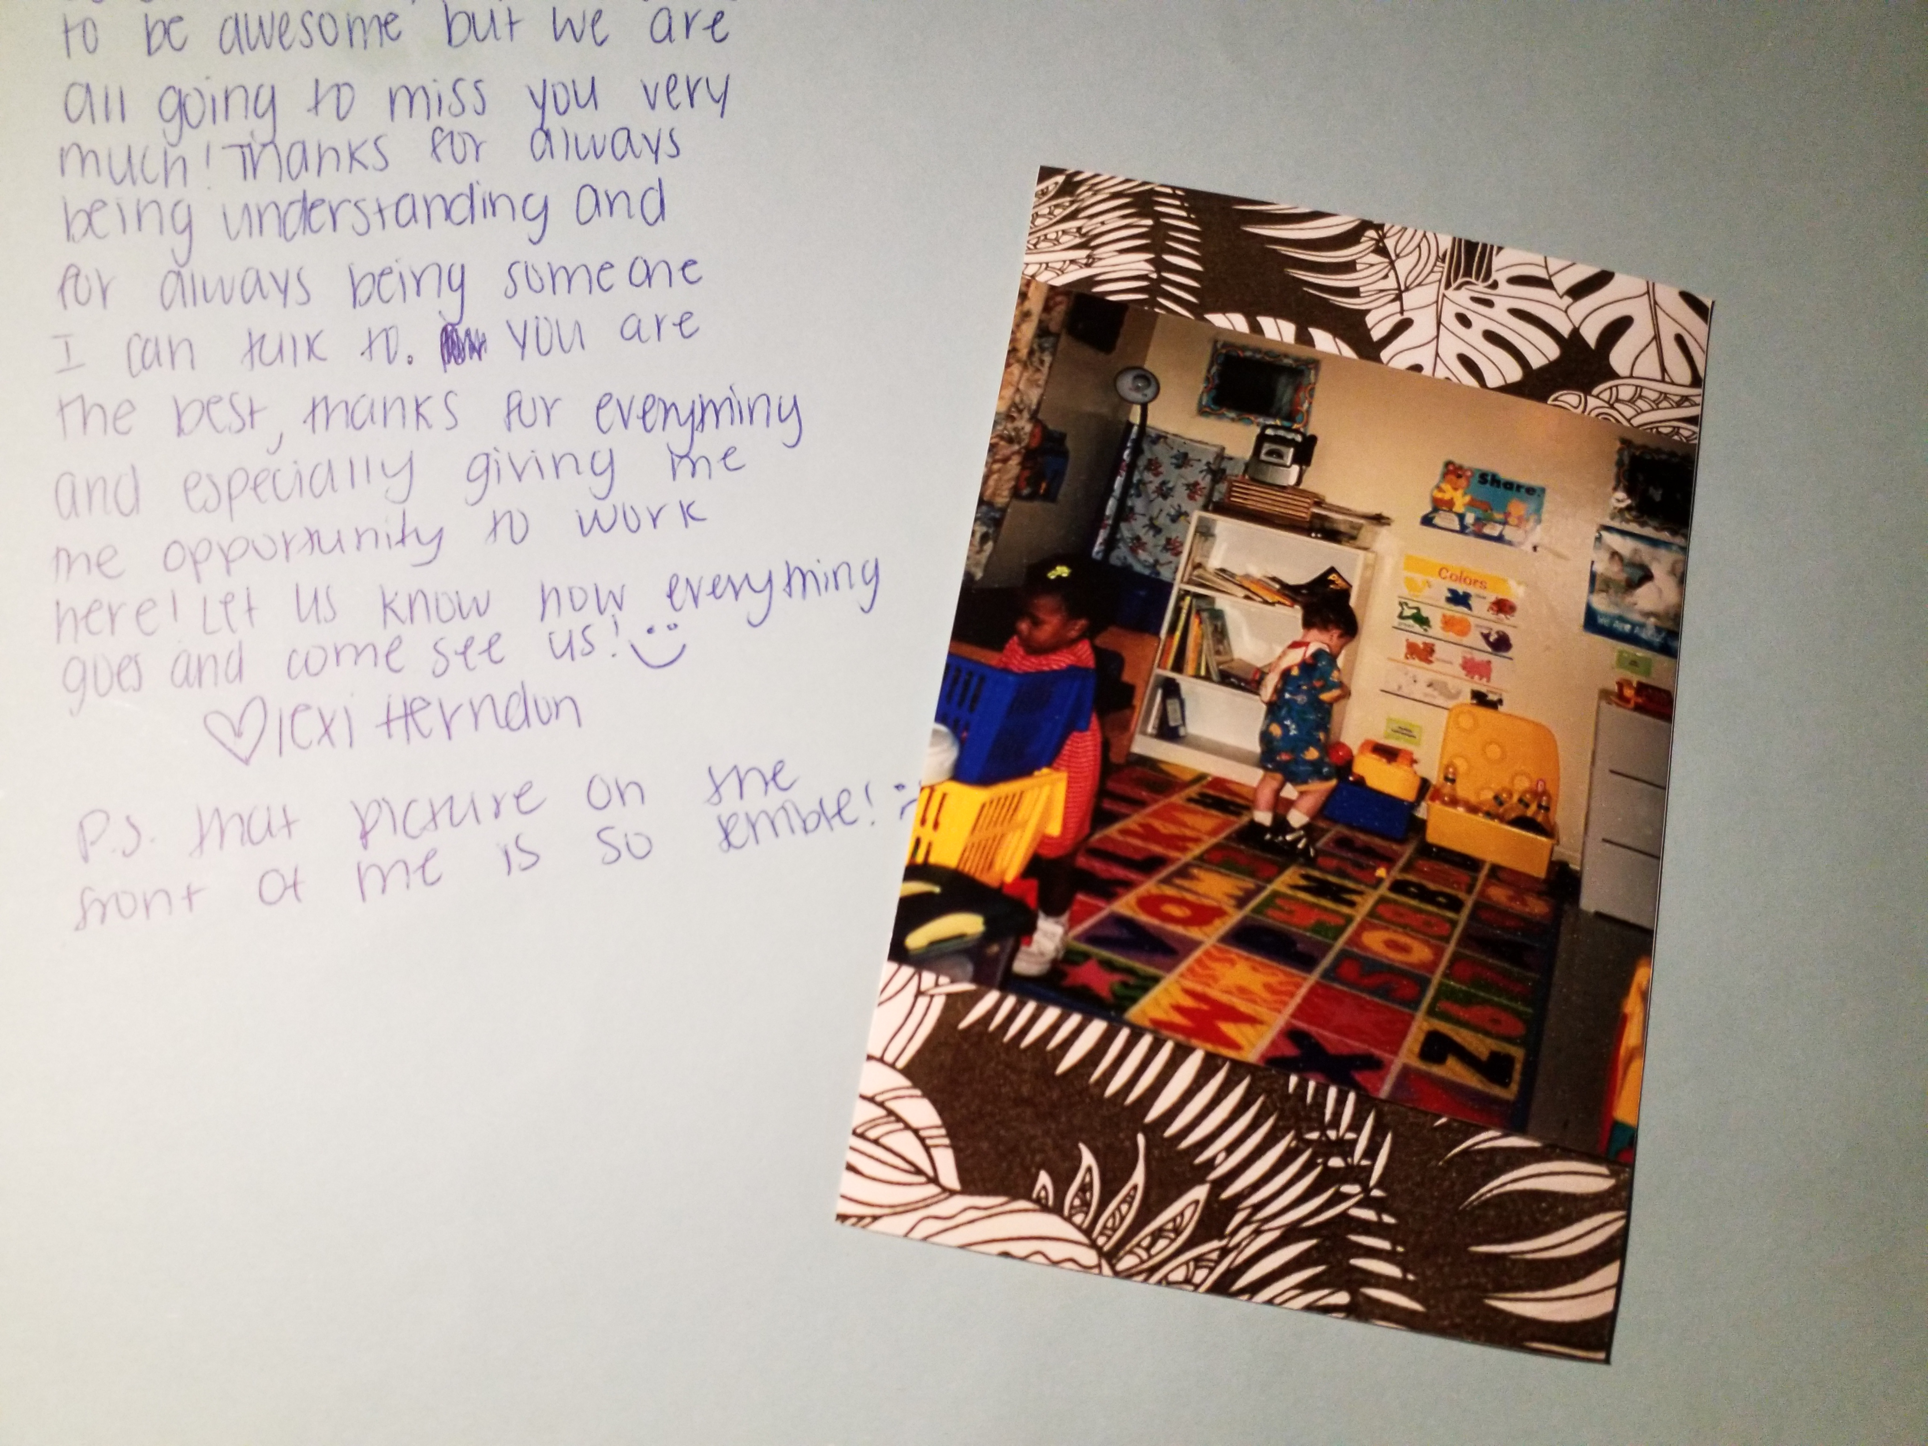
Curiosities set in…
What does a professional look like in the early childhood field?
According to Morrison (2013), “an early childhood professional has the professional characteristics, knowledge, and skills necessary to teach and conduct programs so that all children learn, as well as the ability to inform the public about children’s families’ issues” (p.4).

Slide 6
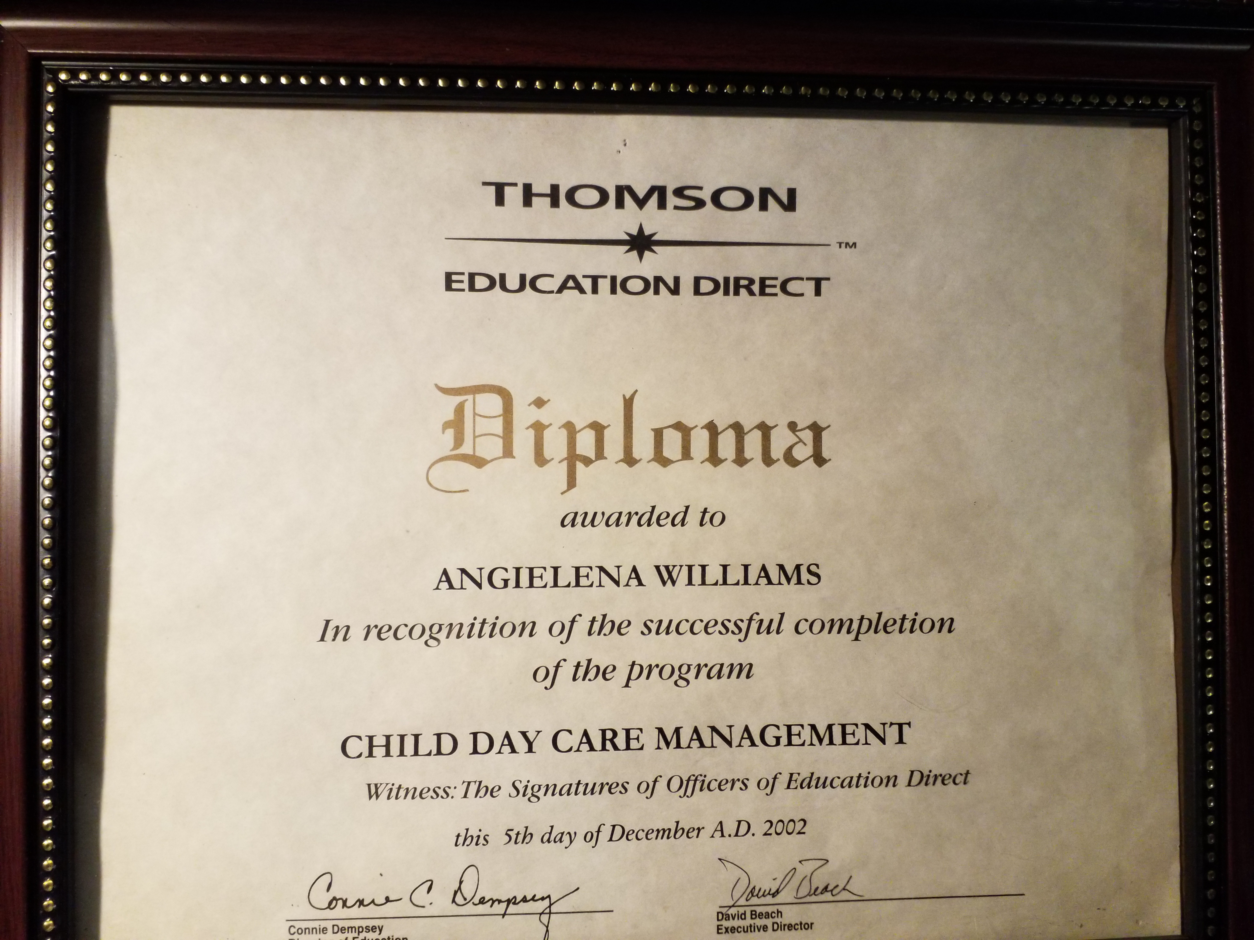
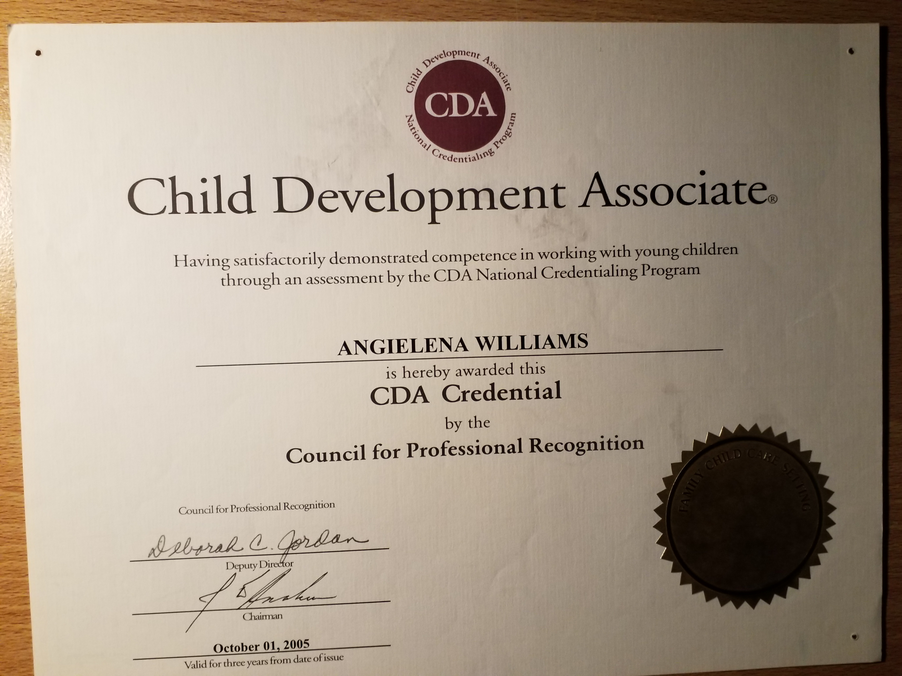
Knowledge is Power!
In Oklahoma, I began night classes at the local vocational college for Child Care Careers
Moved to Georgia and continued in an on-line correspondence program, Education Direct, to receive a Career Diploma in Child Day Care Management
In Indiana, began course work with the local child care resource and referral agency for my Child Development Associate Credential
…and then…

Slide 7
Career Opportunities in ECE
…I began working in other areas of the early childhood profession!
Licensed and Accredited Family Child Care Home
Healthy Families Family Support Worker
Early Intervention Instructional Assistant
Program Director of a Child Care Ministry
Program Director of a Corporate Child Care Center
General Education Preschool Teacher in Public Schools
Early Childhood Development Teacher in the Teaching, Learning and Leading Academy
Family Child Care Provider
Caregiver
Lead Teacher
Assistant Teacher
Director
Assistant Director
Home Visitor
Teacher Preschool-3rd Grade
Early Interventionist
…and more!

Slide 8
“Whenever you see a successful person, you only see the public glories, never the private sacrifices to reach them.” – Vaibhav Shah

Slide 9
The Five Goals of Professionalism
#1 – Child Development and Learning

Slide 10
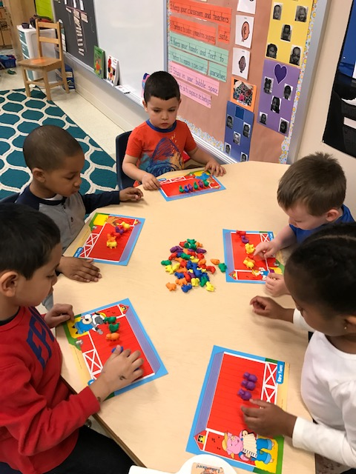
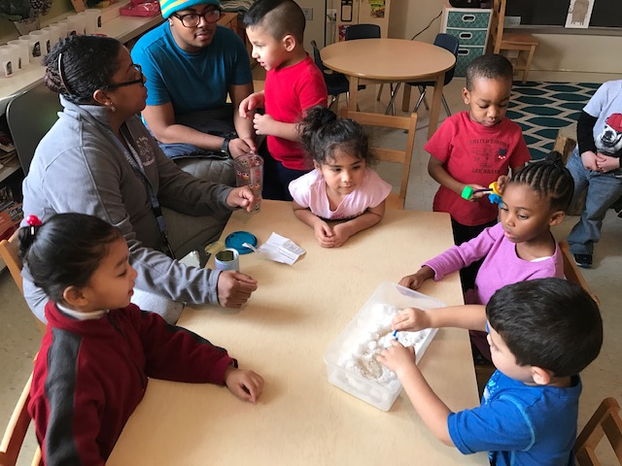
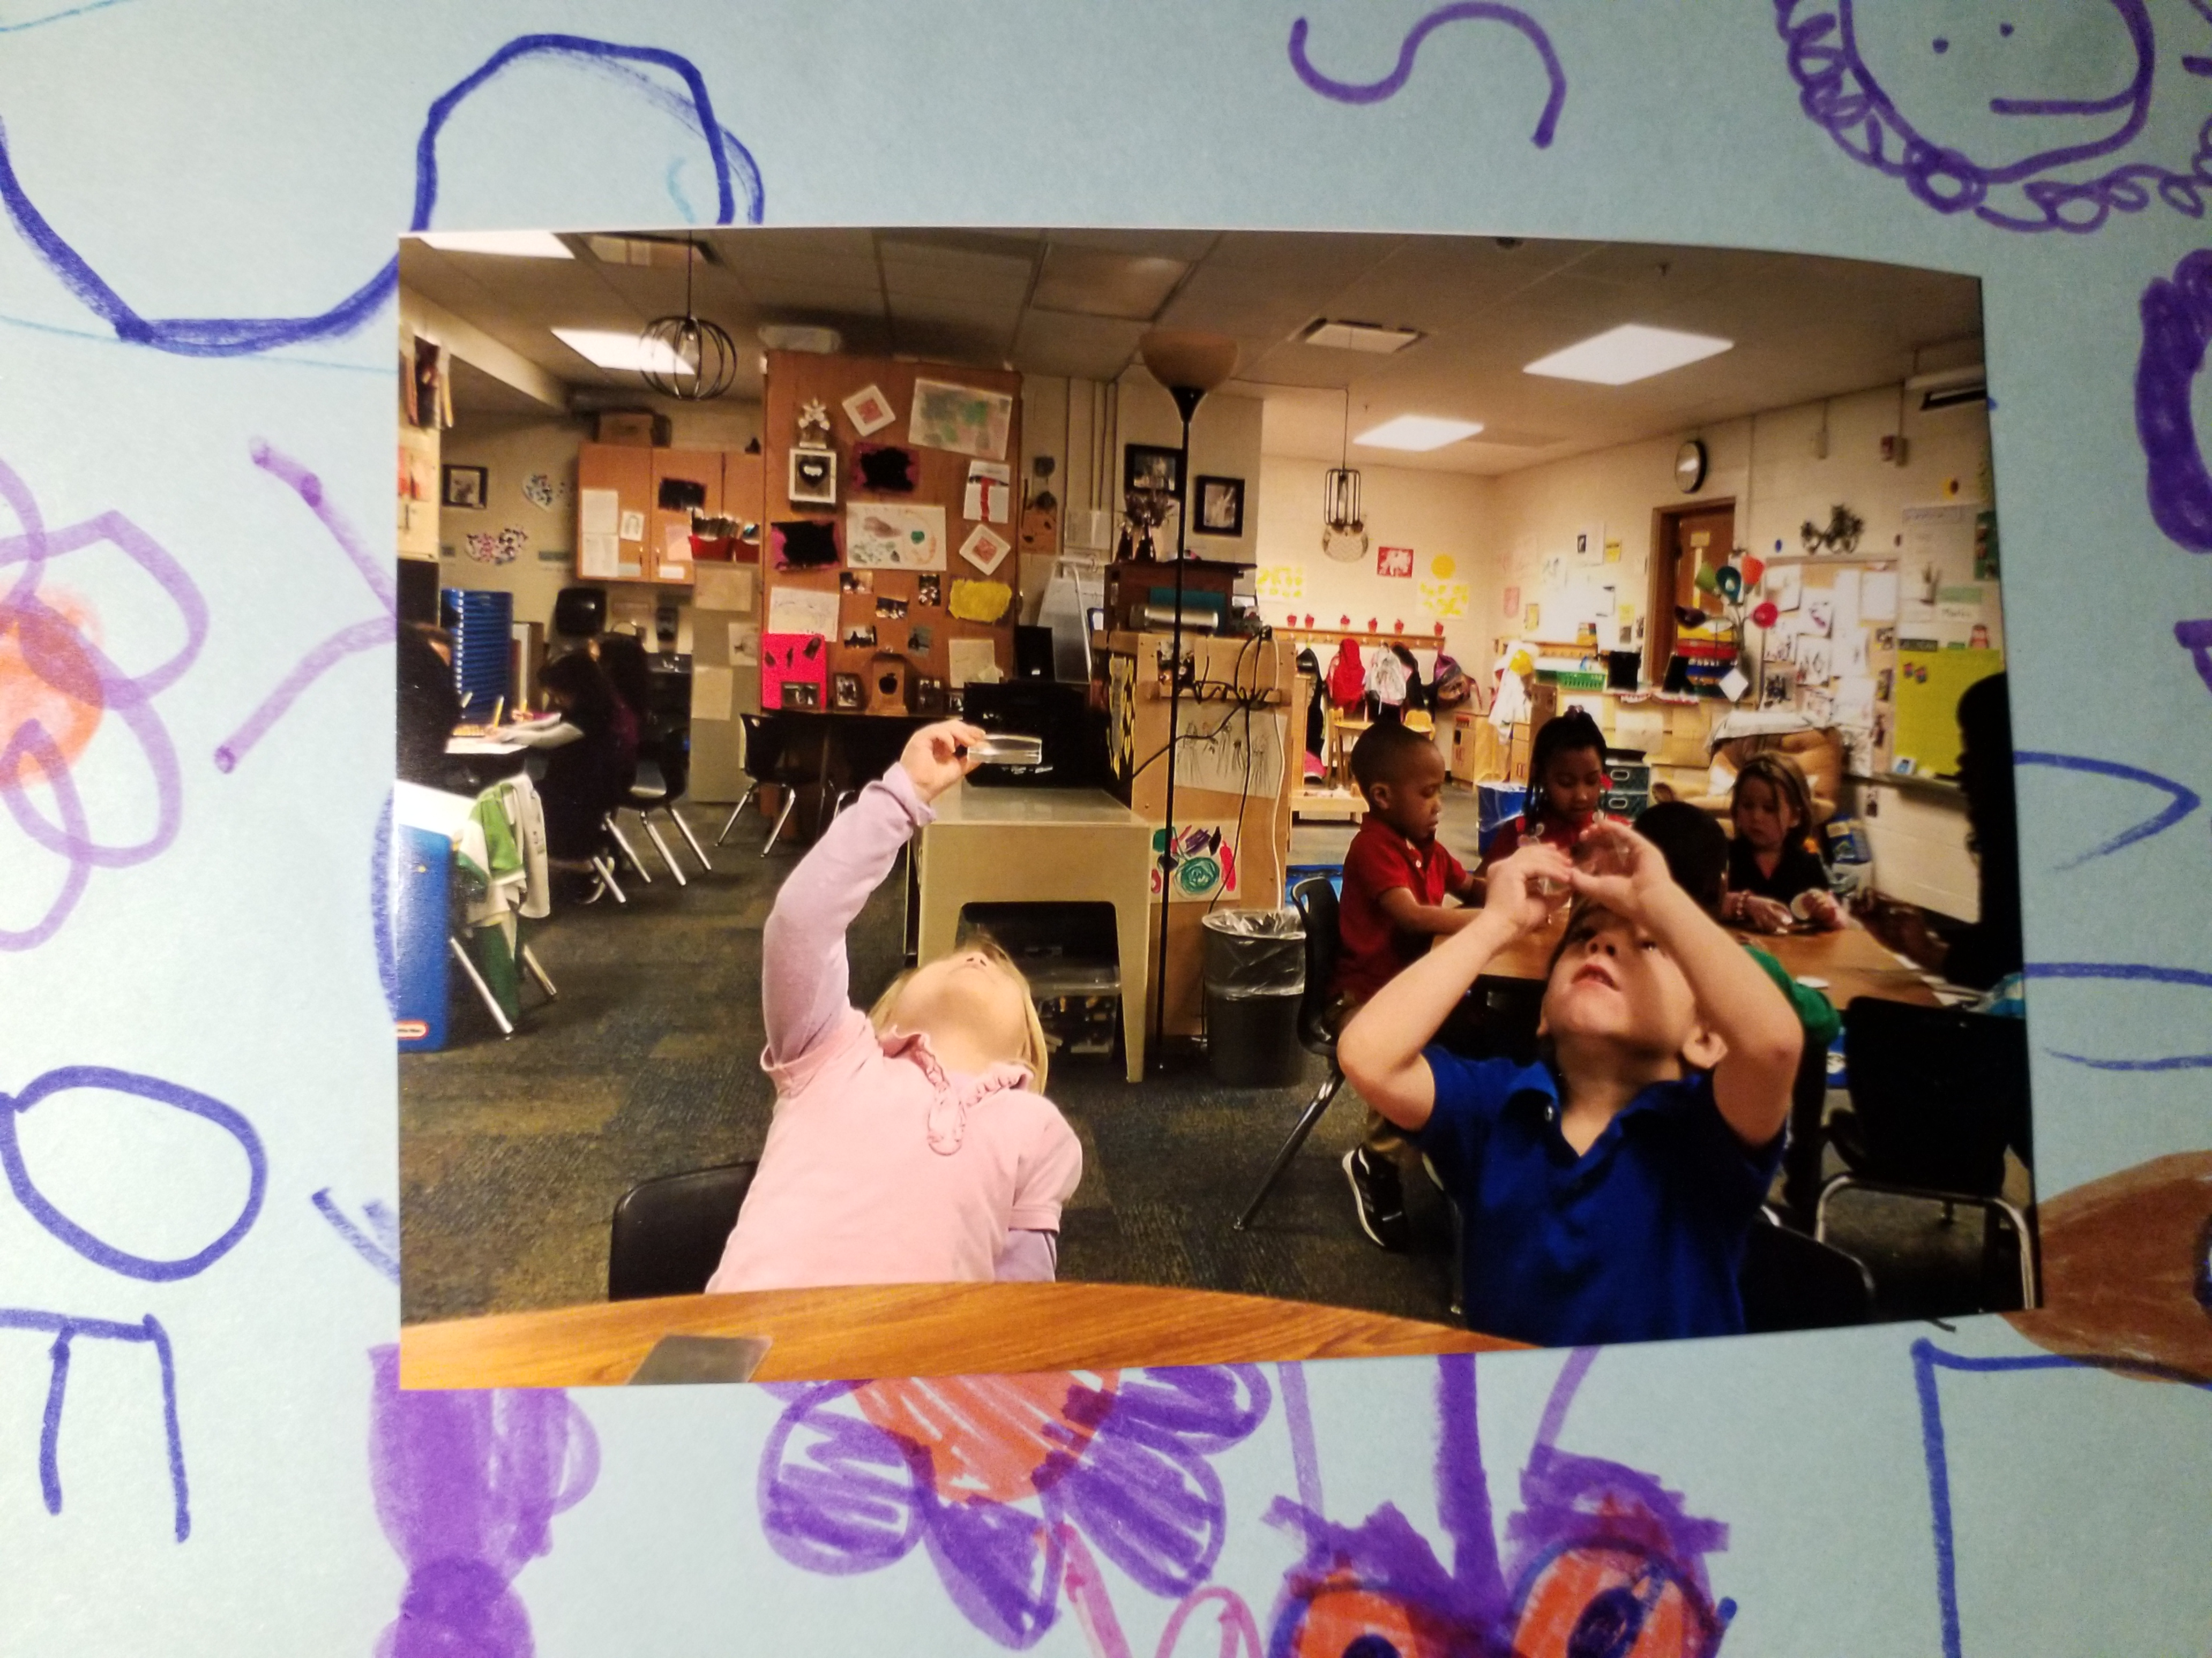

Slide 11
The Five Goals of Professionalism
#2 - Building Family and Community Relationships

Slide 12
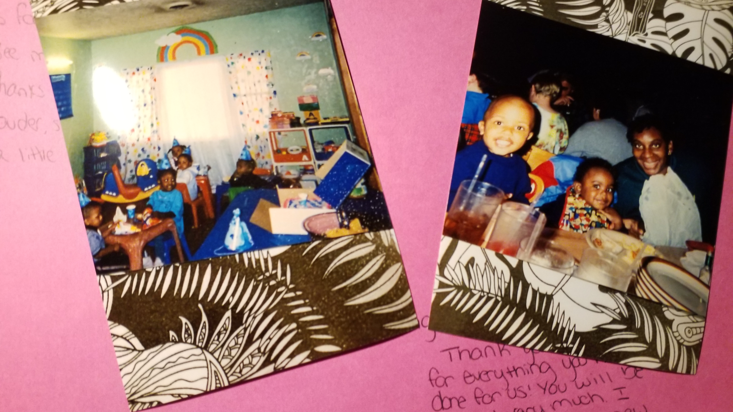

Slide 13
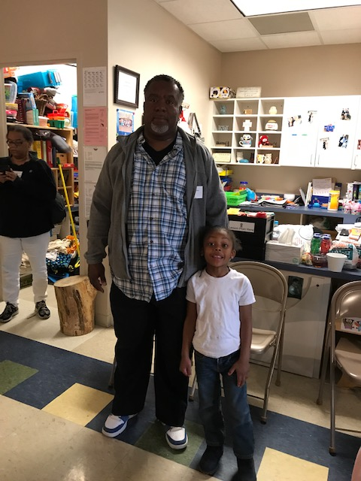
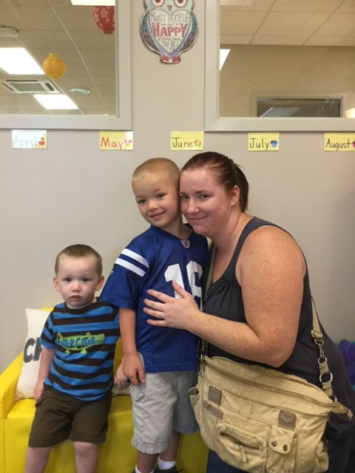
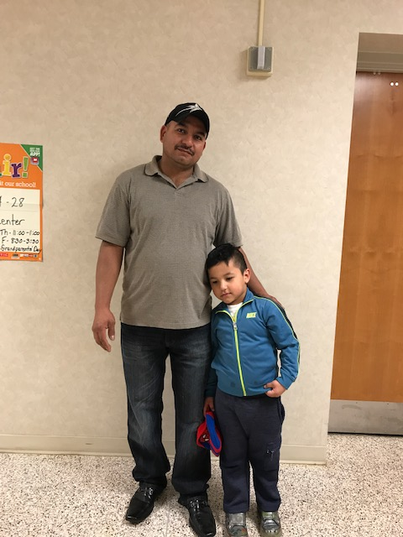
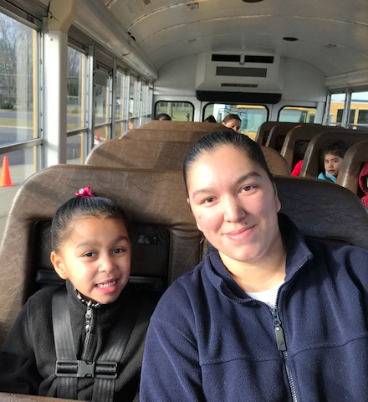

Slide 14
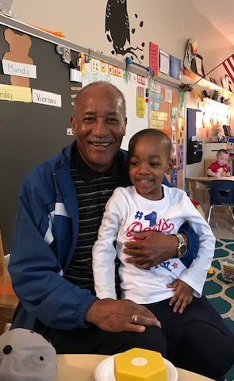
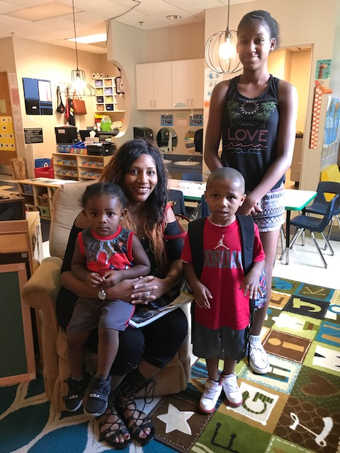
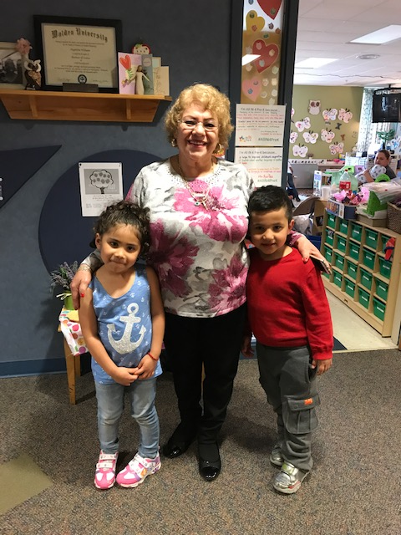

Slide 15
The Five Goals of Professionalism
#3 – Observing, Documenting, and Assessing to Support Children and Families

Slide 16
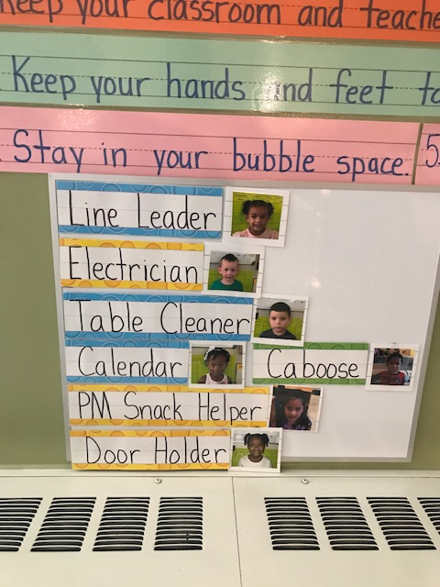
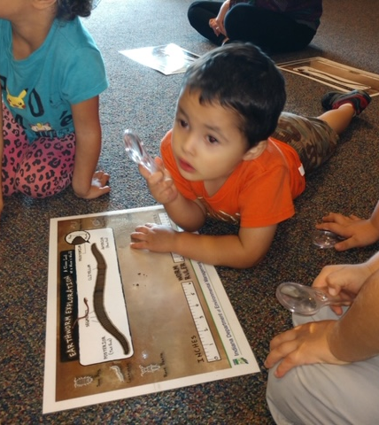
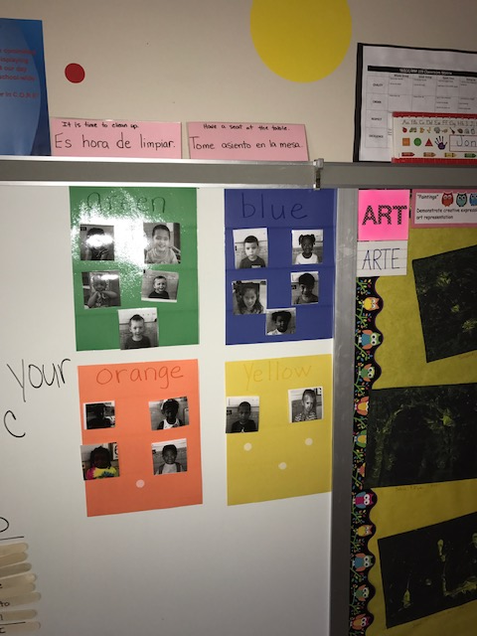
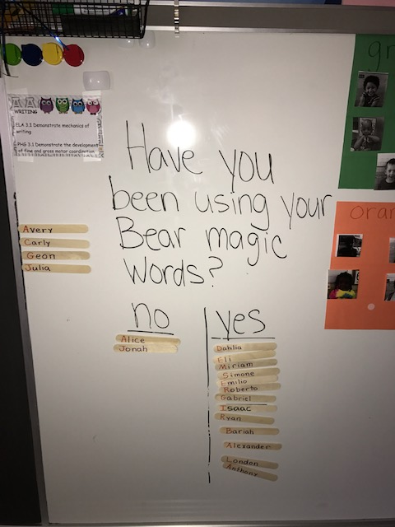

Slide 17
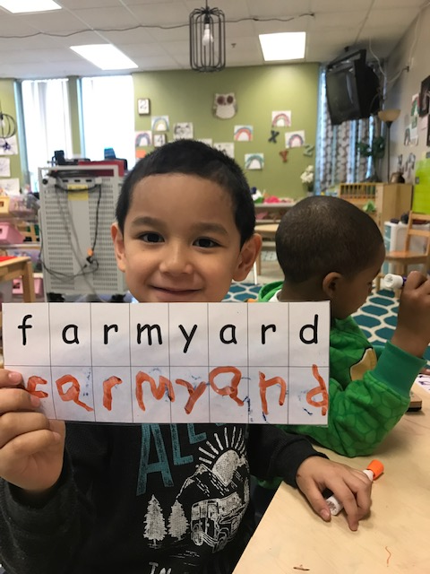
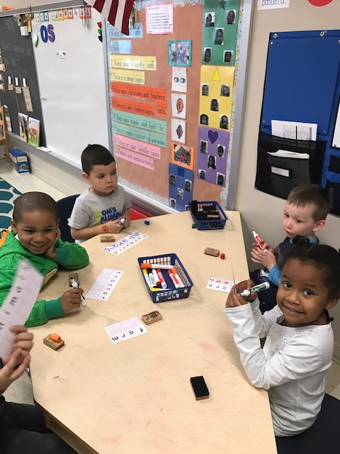
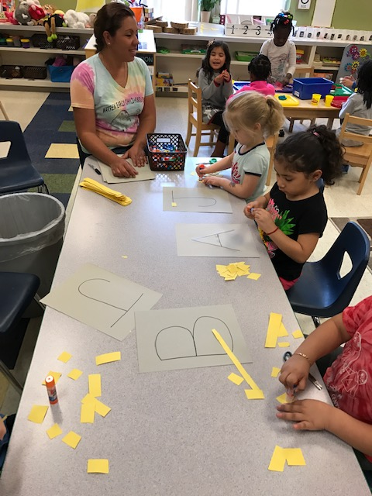
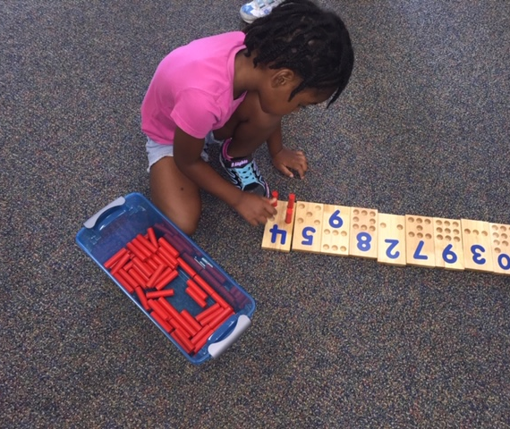

Slide 18
The Five Goals of Professionalism
#4 – Teaching and Learning

Slide 19
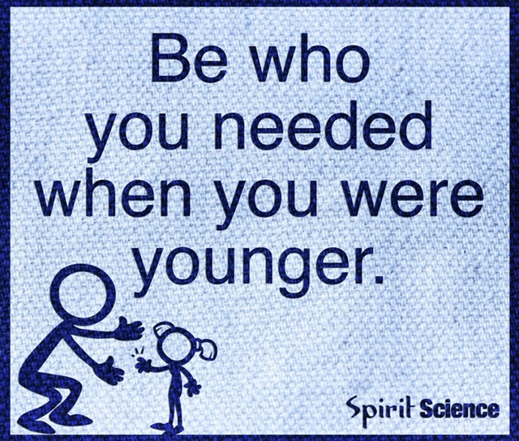

Slide 20
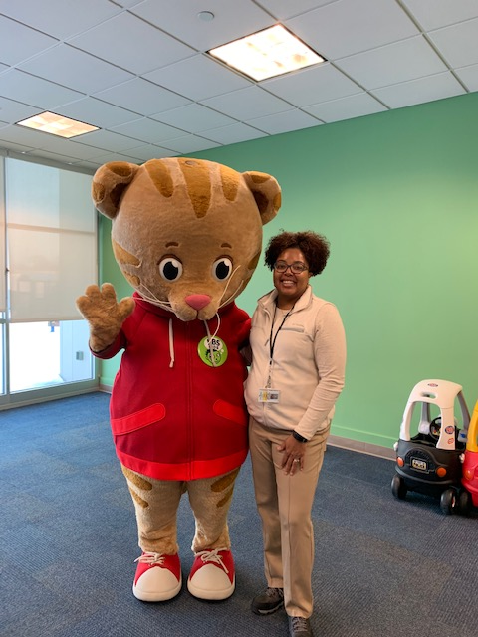
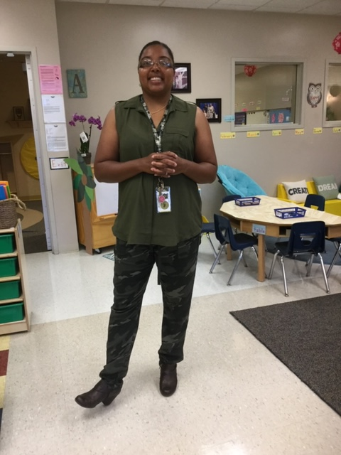
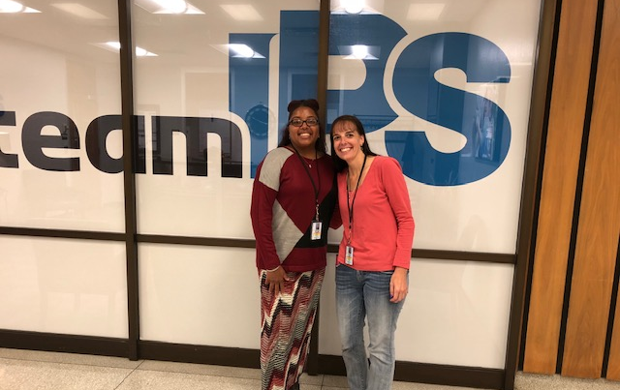
The Five Goals of Professionalism
#5 – Becoming a Professional

Slide 21
The Five Goals of Professionalism implies that one should…
Know about and engage in ethical practice
Engage in continuous lifelong learning and professional development
Collaborate with colleagues, parents, families, and community partners
Engage in reflective practice
Advocate on behalf of children, families, and the profession

Slide 22
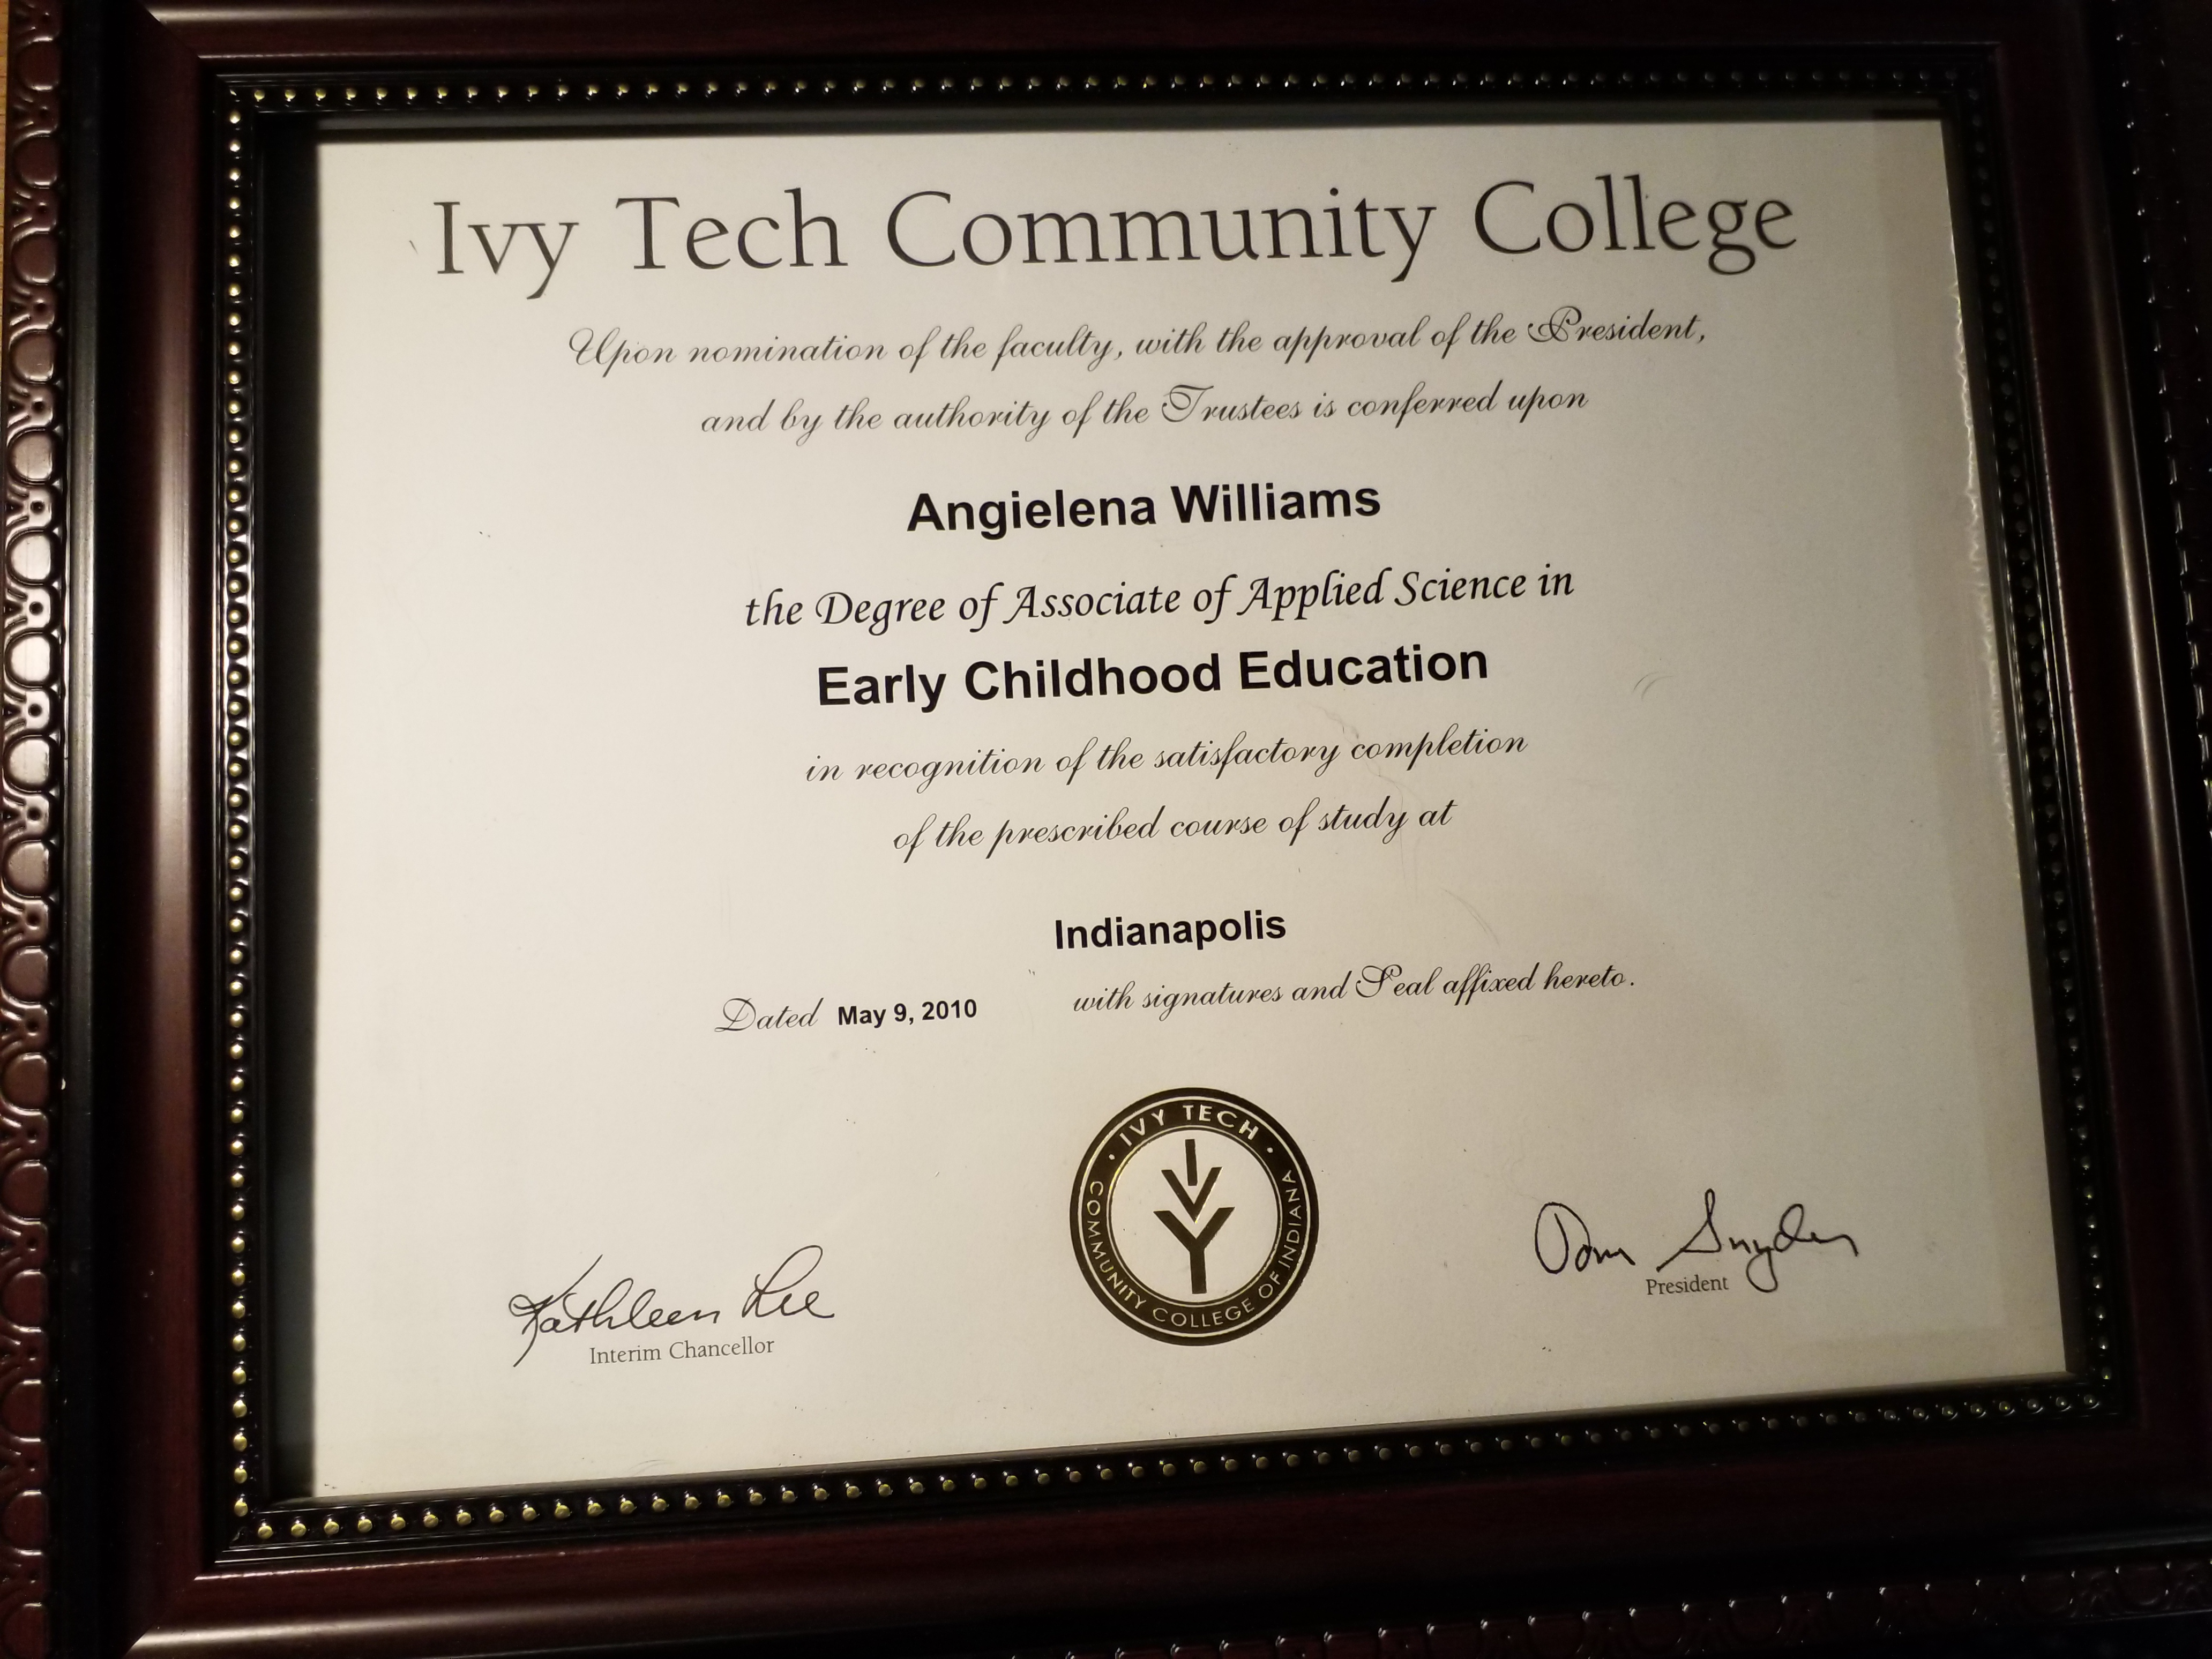
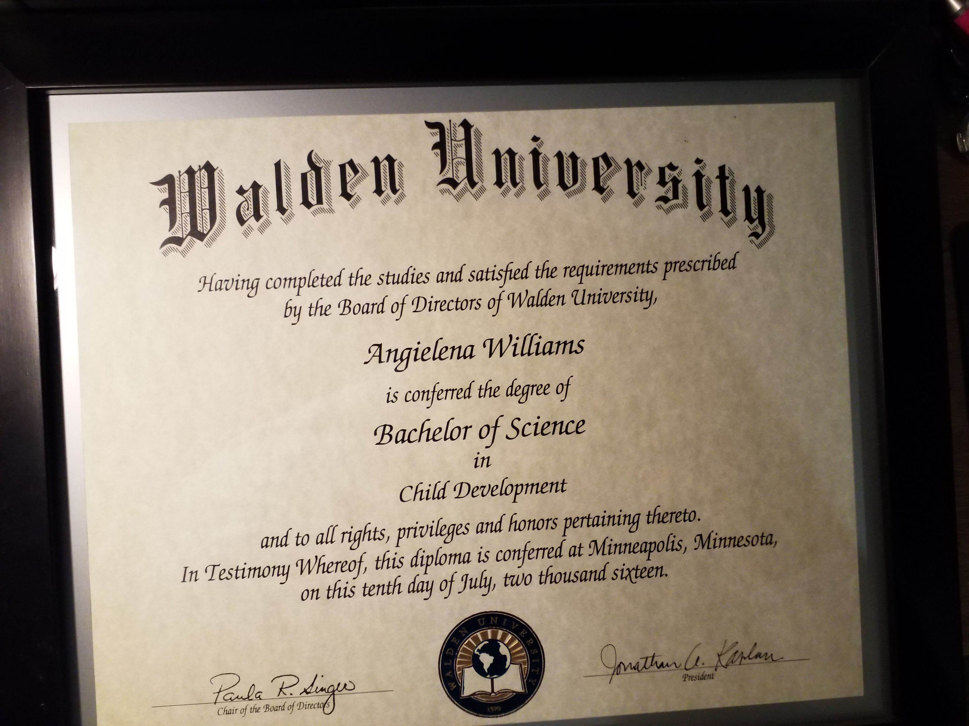
My lifelong learning has…
Inspired me to obtain my A.A.S. in ECE
Further inspired me to obtain my B.S. in CD

Slide 23
Be Inspired!
Humble beginnings
Never give up
Begin with the end in mind
Stay focused
BELIEVE!

Slide 24
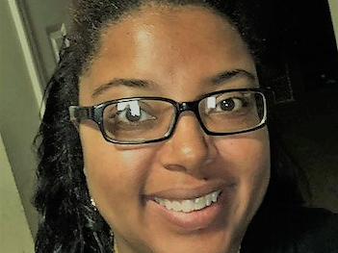
REFERENCES
Mind Benders Retrieved from: http://www.childcareexchange.com/mb
Morrison, G.S. (2013). Early Childhood Education Today, 11/e. Pearson; Boston, MA

